Slide 1

Work Queue System

Slide 2
目录
What is work queue system？
A Generic Work Queue System
Hands On: Implementing a Video Thumbnailer

Slide 3
01
What is work queue system？

Slide 4
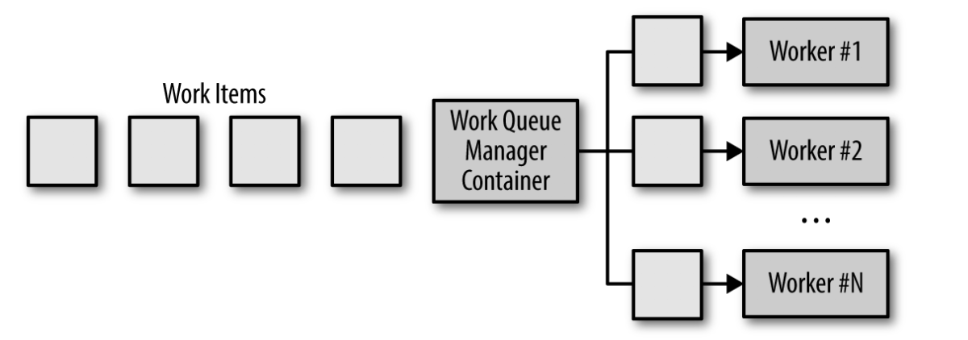
What is work queue system?
Work Queue System
the simplest form of batch processing.
Each piece of work is wholly independent of the other and can be processed without any interactions.
Generally, the goals of the work queue system are to ensure that each piece of work is processed within a certain amount of time.
Workers are scaled up or scaled down to ensure that the work can be handled.
Notes:
本篇介绍批处理的模式。与先前介绍的长时间运行应用所不同的是，批处理的过程预计只能运行很短的时间。例如，通过汇总用户的数据来分析每天或每周的销售情况，或者是转码视频文件等。批处理的特征为用很快的速度来处理大量的数据，其中通过并行的方式来加快处理速度。
作业之间相互独立
确保每个作业在一定的时间内完成
worker可以动态地进行扩容、缩容来确保作业的执行

Slide 5
02
A Generic Work Queue System

Slide 6
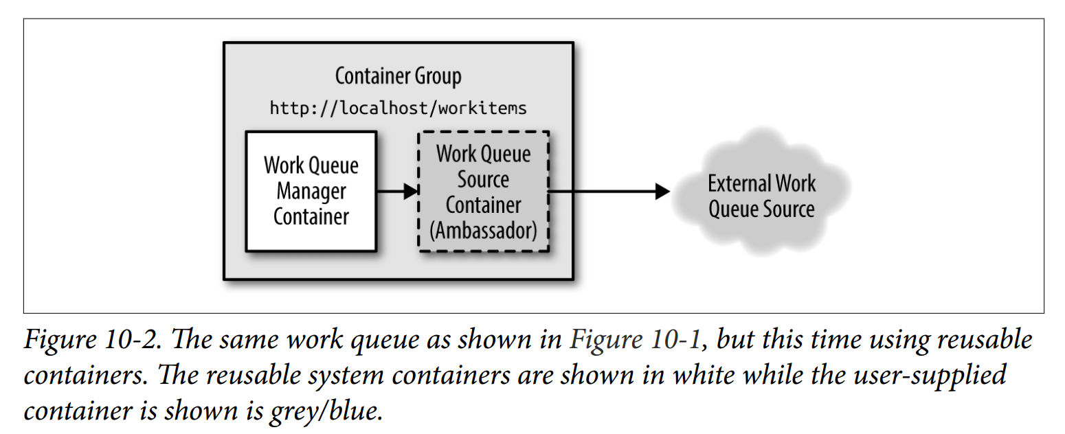
A Generic Work Queue System
Most of the logic in the work queue is wholly independent of the actual work being done, and in many cases the delivery of the work can be performed in an independent manner as well. To illustrate this point, consider the work queue illustrated in Figure 10-1. If we take a look at it again and identify functionality that can be provided by a shared set of library containers, it becomes apparent that most of the implementation of a containerized work queue can be shared across a wide variety of users.
Notes:
作业队列中的大部分逻辑完全独立于正在被处理的作业，并且在很多情况下，作业的交付也可以以独立的方式执行，可以通过图1来思考这一点。同时，它也可以通过一组共享的容器库来提供功能，如图2所示，大部分容器化的作业队列可以在各种各样的用户之间进行共享，可重复使用的系统容器显示为白色，而用户提供的容器显示为灰色。

Slide 7
A Generic Work Queue System
Building a reusable container-based work queue requires the definition of interfaces between the generic library containers and the user-defined application logic. In the containerized work queue, there are two interfaces:
the source container interface
provides a stream of work items that need processing
the worker container interface
knows how to actually process a work item
Notes:
构建基于容器的工作队列需要在通用库容器和用户定义的应用逻辑之间定义接口。在容器化的作业队列中，有两个接口：
the source container interface提供需要处理的作业
the worker container interface知道如何处理作业

Slide 8
The Source Container Interface
To operate, every work queue needs a collection of work items that need processing.There are many different sources of work items the work queue, depending on the specific application of the work queue. However, once the set of items has been obtained, the actual operation of the work queue is quite generic. Consequently, we can separate the application-specific queue source logic from the generic queue processing logic. Given the previously defined patterns of container groups, this can be seen as an example of the ambassador pattern defined previously. The generic work queue container is the primary application container, and the application-specific source container is the ambassador that proxies the generic work queue’s requests out to the concrete definition of the work queue out in the real world.
Notes:
作业队列有不同的作业来源，这取决于作业队列的特定应用程序。但是一旦作业队列获取一组作业，work queue处理作业的方式就非常通用了。因此，我们可以将基于特定应用的work queue的处理逻辑与通用的work queue的处理逻辑分离。
这个可以看做是大使模式的例子：通用的work queue container是主要的应用容器，基于特定应用的容器是大使容器，它可以将通用的work queue的请求代理到某个具体定义的work queue。

Slide 9
The Worker Container Interface
This container and interface are slightly different than the previous work queue source interface for a few reasons:
The first is that it is a one-off API: a single call is made to begin the work, and no other API calls are made throughout the life of the worker container.
Secondly, the worker container is not inside a container group with the work queue manager. Instead, it is launched via a container orchestration API and scheduled to its own container group. This means that the work queue manager has to make a remote call to the worker container in order to start work. It also means that we may need to be more careful about security to prevent a malicious user in our cluster from injecting extra work into the system
Notes:
worker container interface与source container interface的不同：
1.它是一次性的API：一次调用就可以开始工作，并且在Worker容器的整个生命周期中不会进行其他API调用
2. Worker容器不在具有作业队列管理系统的容器组内，而是通过容器编排的API启动的，并调度到自己所在的容器组中，这意味着作业队列管理系统必须对Worker容器进行远程调用才能开始工作，这也意味着我们需要更加小心，以防集群中的恶意用户向系统中注入额外的作业。

Slide 10
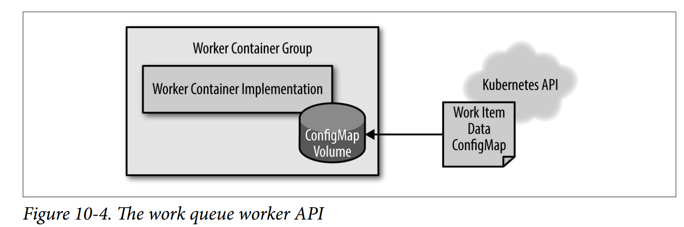
The Worker Container Interface
For the worker container, we will use a file-based API. Namely, when the worker container is created, it will receive an environment variable named WORK_ITEM_FILE; this will point to a file in the container’s local filesystem, where the data field from a work item has been written to a file. Concretely, as you will see below, this API can be implemented via a Kubernetes ConfigMap object that can be mounted into a container group as a file.
Notes:
通过 Work Queue Source API，我们使用一个简单的基于HTTP的API将作业发送回作业队列管理系统，这是因为我们需要重复调用API，因为所有的都是在localhost上运行的，所以安全性并不是问题。通过Worker容器，我们只需要进行一次调用，并且我们希望确保系统中的其他用户不会意外地或恶意地向Worker添加作业。所以，对于Worker容器，我们使用基于文件的API，也就是说，当创建Worker时，它将接收一个名为WORK_ITEM_FILE的环境变量，它将指向本地文件系统容器中的一个文件，其中来自作业项的数据字段已经被写入文件。
这个API可以通过一个 Kubernetes ConfigMap 对象来实现，该对象可以作为一个文件被装载到一个容器组中。

Slide 11
The Worker Container Interface
Often a work queue worker is simply a shell script across a few command line tools. In that context, spinning up a web server to manage the work to perform is an unnecessary complexity. As was true with the work queue source implementation, most of the worker containers will be special-purpose container images built for specific work queue applications, but there are also generic workers that can be applied to multiple different work queue applications.
Notes:
这个基于文件的API模式对容器来说也更容易实现，通常一个作业队列的Worker只是一个shell脚本，在这种情况下，就没有必要启动 Web 服务器来管理要执行的作业。与 Work Queue Source 的实现一样，大多数的作业容器都是为特定作业队列应用程序构建的专用容器镜像，但也有通用的 Worker 可应用于多种不同的作业队列应用程序。

Slide 12
The Shared Work Queue Infrastructure
What is left to implement our reusable work queue implementation? The basic algorithm for the work queue is fairly straightforward:
1. Load the available work by calling into source container interface.
2. Consult with work queue state to determine which work items have been pro‐
cessed or are being processed currently.
3. For these items, spawn jobs that use the worker container interface to process the
work item.
4. When one of these worker containers finishes successfully, record that the work
item has been completed.
Kubernetes contains a Job object that allows for the reliable execution of the work queue. The Job can be configured to either run the worker container once or to run it until it completes successfully. Additionally, Kubernetes has annotations for each Job object that enable us to mark each job with the work item it is processing. This enables us to understand which items are being processed as well as those that have completed in either failure or success.
Notes:
鉴于前面介绍的两个容器接口的实现，为了实现我们的可重用作业队列，我们还需要实现什么呢？作业队列的基本算法非常简单：
1.通过调用 Source Container Interface 来加载空闲的作业；
2.通过查询作业队列的状态来确定哪些作业已经被处理或者正在被处理当中；
3.对于这些作业项，生成一些使用 Worker Container Interface 进行处理的作业；
4.当其中一个Worker容器完成时，记录下那些已经被完成的作业。
虽然这种算法很容易用文字去表达，但实际上，实现起来要复杂一些，幸运的是，Kubernetes 的容器编排包含了许多特性，使其更容易实现。也就是说，Kubernetes包含了一个Job对象，这允许可靠执行的作业队列，作业可以配置为在 Worker 容器上只运行一次或者一直运行直到它成功完成。如果Worker容器设置为运行完成，那么即使集群中的某台机器发生故障，作业最终也会成功运行，这样极大地简化了作业队列的构建，因为编排系统对每个作业的可靠执行负责。
整体来讲，这意味着我们可以在 Kubernetes 的编排系统层之上实现一个作业队列，而无需使用我们自己的任何存储，这极大地简化了构建作业队列基础结构的任务。
因此，我们使用如下的方式进行作业队列容器的扩容操作：
重复的进行如下操作：
1.从 Work Source Container Interface 获得作业项的列表；
2.获得为服务此作业队列而创建的所有作业的列表；
3.通过对列表中的作业进行区分来获得尚未进行处理的作业项集合；
4.对于这些没有处理的作业项，创建新的Job对象，以生成适当的 Worker 容器。

Slide 13
Dynamic Scaling of the Workers
The previously described work queue is great for processing work items as quickly as they arrive in the work queue, but this can lead to bursty resource loads being placed onto a container orchestrator cluster. This is good if you have a lot of different work‐ loads that will burst at different times and thus keep your infrastructure evenly utilized. But if you don’t have a sufficient number of different workloads, this feast or famine approach to scaling your work queue might require that you over-provision resources to support the bursts that will lay idle (and cost too much money) while you don’t have work to perform.
To address this problem, you can limit the overall number of Job objects that your work queue is willing to create. This will naturally serve to limit the number of work items you process in parallel and consequentially limit the maximum amount of resources that you use at a particular time. However, doing this will increase the time to completion (latency) for each work item being completed when under heavy load.If the load is bursty, then this is probably okay because you can use the slack times to catch up with the backlog that developed during a burst of usage. However, if your steady-state usage is too high, your work queue may never be able to catch up and the time to completion will simply get longer and longer.
Notes:
先前描述的作业队列对于到达作业队列中作业项的处理速度非常快，但是这会导致突发性资源负载被放置到集群的编排系统集群上，如果你有许多不同的工作负载在不同的时间爆发还好，因为这样可以保证基础框架的平均资源利用率，但是如果你没有足够数量的不同负载，通过过多或者过少的方式来缩放作业队列，那么就需要你通过 Over-Provision Resource 的方式来支持这种突发负载的发生，同时当没有那么多作业需要处理时，那些过度分配的资源就会闲置下来，从而造成很大的浪费（资源／金钱）。
为了解决这个问题，可以限制作业队列创建的 Job 对象的总数，这样做自然会限制作业处理的并行性，并因此限制你在特定时间可以使用的最大资源量。然而，这样做会增加在高负载下作业完成的时间，如果负载是突发性的，那还好，因为你可以用冗余（slack）的时间来处理高负载下积压的作业，但是，如果在平时稳定的状态下利用率就很高，那么在高负载下作业队列可能永远无法赶上来，作业完成的时间将会变得越来越长。
当你的作业队列面临这种情况时，你需要让它自己动态调整来增加并行性（相应的增加资源）以便跟上不断进入队列的作业。幸运的是，我们可以使用数学公式来确定何时需要对我们的作业队列进行动态扩容。
思考一个这样的作业队列，平均每分钟会有一个新的作业项到达，每个作业项平均需要30秒才能完成，这样的系统能够跟上它接收到的所有作业，即使大量的作业同时到达并产生了积压，平均而言，作业队列会处理2个到达的作业项，因此它可以逐步完成这些积压的作业。
相反，如果一个作业队列平均每分钟会有一个新的作业项到达，每个作业平均需要1分钟才能完成，那么这个系统是完全平衡的，但它不能很好的处理突发负载，它可以在突发负载的情况下赶上，但是这需要一段时间，并且它没有冗余的时间或能力来处理作业到达速率的持续增长。这可能不是一个理想的运行方式，因为保持一个稳定的系统需要一些安全余量，通过这些安全余量来保持增长和其他作业量的持续增长或者作业处理过程中的意外减速。
最后，考虑一个每分钟都会有一个作业项到达的系统，每个作业项需要2分钟来处理。在这样一个系统中，作业的队列将会无限制的增长，队列中的作业项的延迟也会无限制的增长，并且用户也会变的十分痛苦。
因此，我们可以跟踪我们作业队列中的一些指标，作业项之间的平均时间将为我们提供新作业的到达时间间隔；我们还可以跟踪作业处理的平均时间（不包括在队列中的时间）。要拥有一个稳定的作业队列，我们需要调整资源的数量，以便处理任何作业项的时间少于新作业项的到达时间。如果我们正在并行处理作业，我们也将作业项的处理时间除以并行度，例如，每个作业项处理需要1分钟，但我们能并行处理四个作业项，则处理一个作业项的有效时间为15秒，因此我们可以保持16秒或者更长的到达时间间隔。
这种方法使构建一个自动调整器来对我们作业队列的大小进行动态扩容非常简单，虽然缩小作业队列的规模有一些棘手，但是可以使用相同的数学计算方法以及启发式的方法来维护资源的安全余量。例如，可以减少并行度，直到某个作业项的处理时间为新作业项到达间隔时间的90%。

Slide 14
The Multi-Worker Pattern
You have three different types of work that you want to perform on a particular work queue item. For example, you might want to detect faces in an image, tag those faces with identities, and then blur the faces in the image. You could write a single worker to perform this complete set of tasks, but this would be a bespoke solution that would not be reusable the next time you want to identify something else, such as cars, yet still provide the same blurring.
To achieve this kind of code reuse, the multi-worker pattern is something of a specialization of the adapter pattern described in previous chapters. In this case, the multiworker pattern transforms a collection of different worker containers into a single unified container that implements the worker interface, yet delegates the actual work to a collection of different, reusable containers.
Notes:
本书的主题之一是使用容器来封装和重用代码，对于本文描述的作业队列模式也是如此。除了重用容器来驱动作业队列本身的模式之外，还可以重用多个不同的容器来进行Worker的实现。例如，假设你有三种不同类型的作业要在特定的作业队列上执行；例如，你可能想要检测图像中的人脸，用身份标记这些人脸，然后模糊图像中的人脸。你可以编写一个Worker来完成这一整套的任务，但是这将是一个定制的解决方案，下次你想识别别的东西时（如汽车），它仍然不能进行重用，但仍然会产生相同的模糊效果。
为了实现这种代码重用，Multi-Worker模式是前面章节中描述的适配器模式的一个特例。在这种情况下，Multi-Worker模式将不同的Worker容器的集合转换为实现Worker接口的单个统一容器，但将实际作业分配给一组不同的可容用容器，

Slide 15
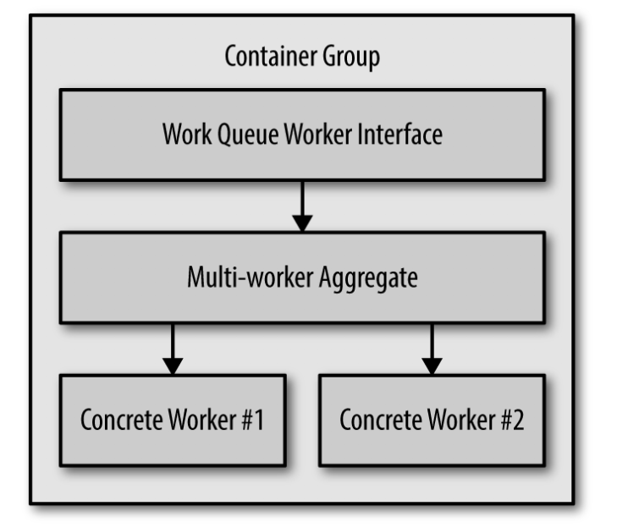
The Multi-Worker Pattern

Slide 16
03
Hands On: Implementing a Video Thumbnailer

Slide 17
Hands On: Implementing a Video Thumbnailer
Hands On
To implement this video thumbnailer, we need two different user containers. The first is the work item source container. The simplest way for this to work is for the work items to appear on a shared disk, such as a Network File System (NFS) share. The work item source simply lists the files in this directory and returns them to the caller.
We use the ffmpeg utility to actually perform the thumbnailing work. You can create a container that uses the following as its command line:
ffmpeg -i ${INPUT_FILE} -frames:v 100 thumb.png
This command will take one frame every 100 frames (that’s the -frames:v 100 flag) and output it as a PNG file (e.g., thumb1.png, thumb2.png, etc.).

Slide 18
谢谢！

